Slide 1



MINX Document 3 Overview and Plume Case Studies
David Nelson, Ralph Kahn, Michael Garay, Sebastian Val,
Michael Tosca, and MISR Staff
Jet Propulsion Laboratory, California Institute of Technology,
Raytheon Company and Columbus Technologies and Services, Inc.
July, 2019
MINX V4.1
Copyright 2019 California Institute of Technology.
Government sponsorship acknowledged.

Slide 2
Contents
Scientific motivation for MINX
MISR Plume Project website
Animations and interpretations with MINX
Smoke plume over Alaska
Dust in Taklamakan Basin
Volcanic ash over Chile
Snow storm in Antarctica

Slide 3
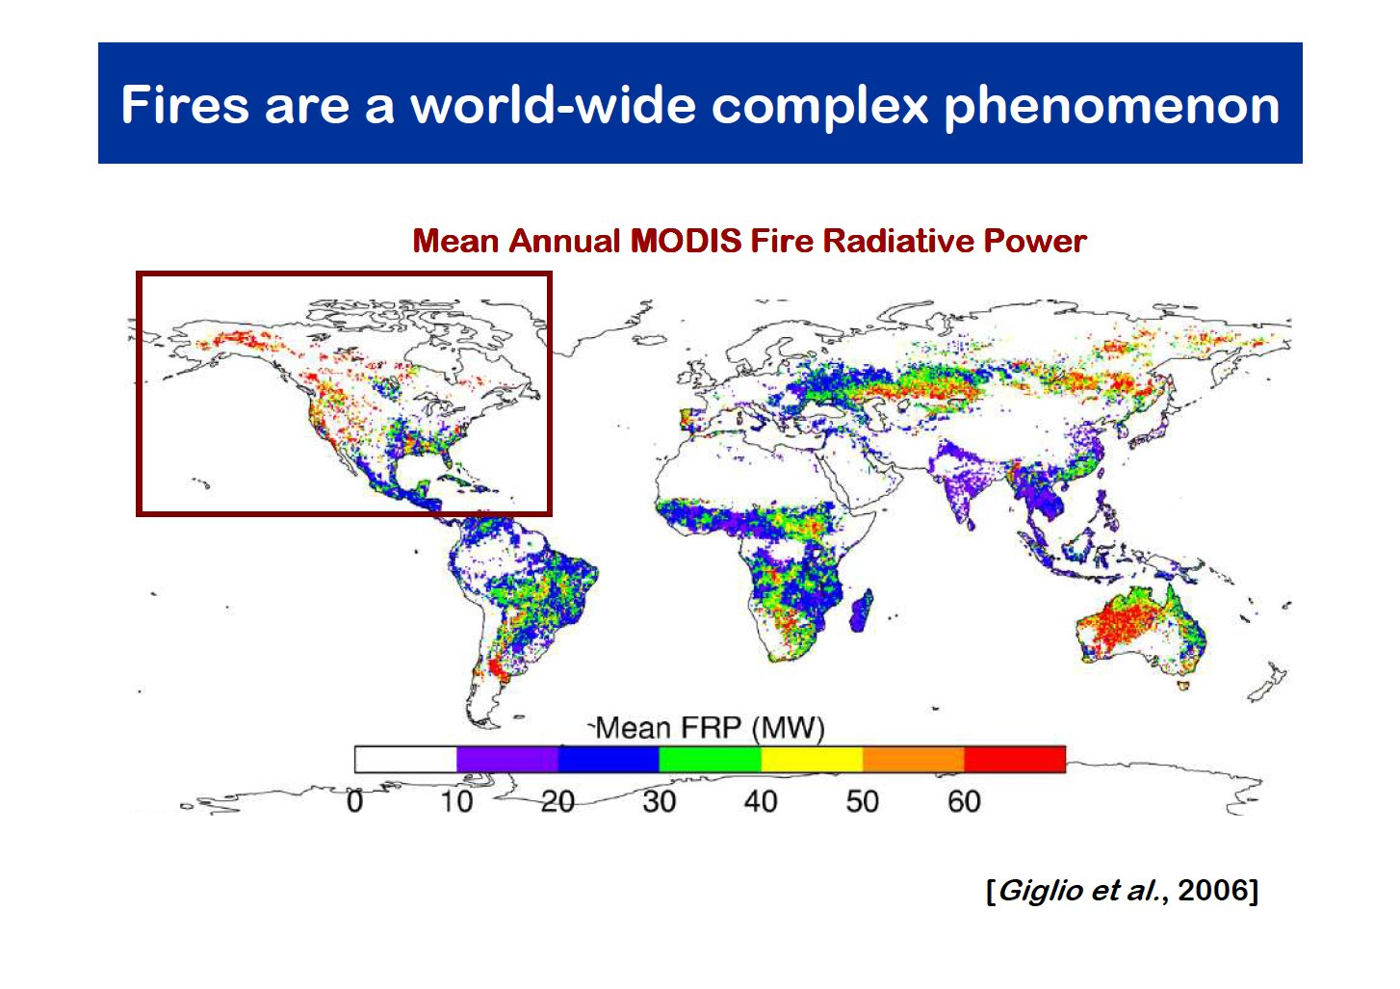

Slide 4
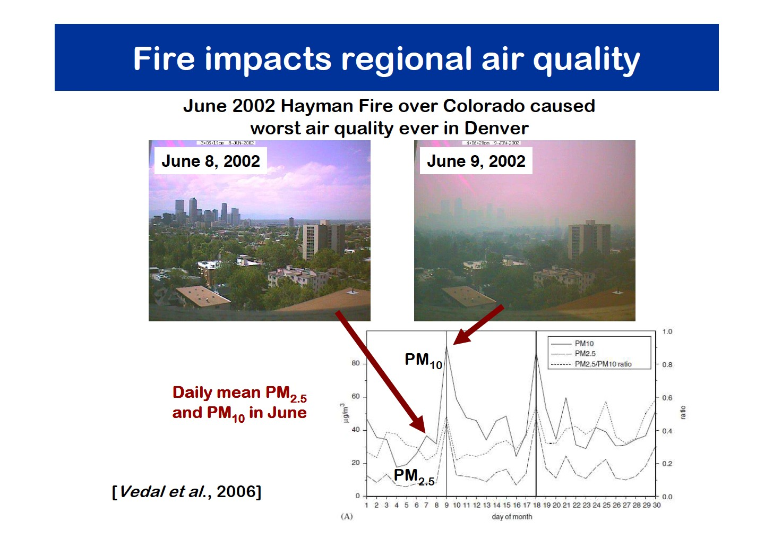
Courtesy of Maria Val Martin

Slide 5
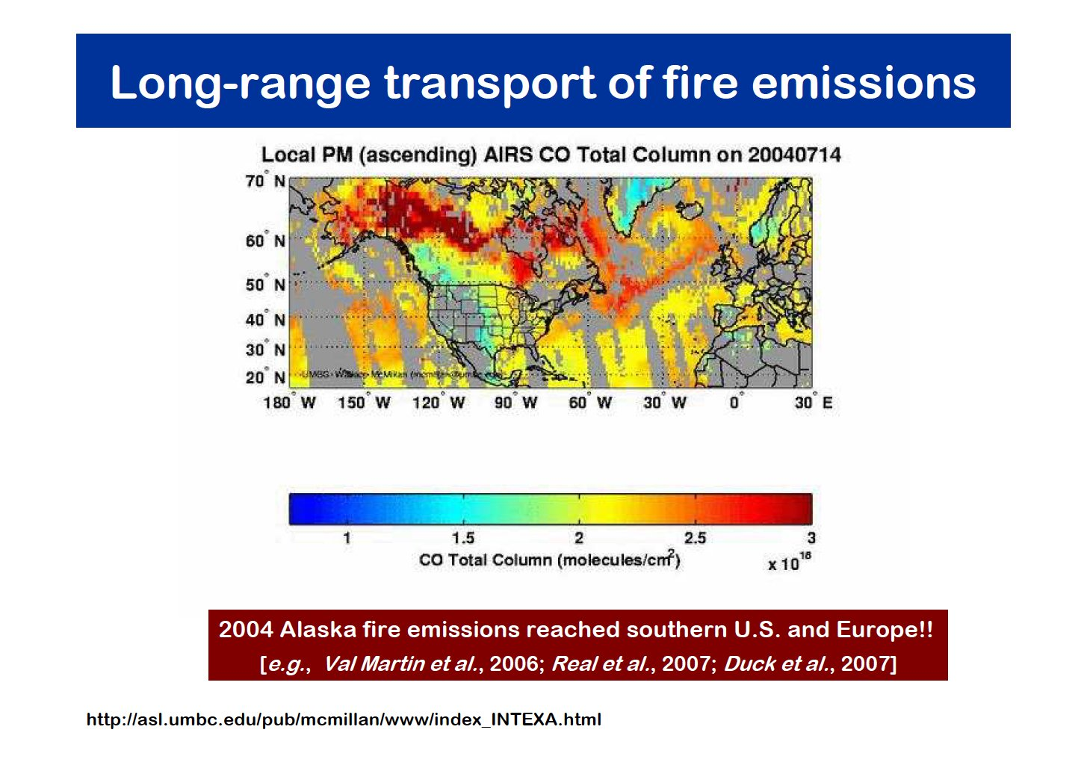
Courtesy of Maria Val Martin

Slide 6
Scientific Motivation for MINX
In 2005, the EPA (Environmental Protection Agency) and NASA funded a proposal to develop an aerosol injection height climatology in support of studying forest fires, climate change and air quality.
Team scientists included: Jennifer Logan (PI – Harvard), David Diner and Dominic Mazzoni (NASA-JPL), Ralph Kahn (NASA-GSFC)
“The elevation at which aerosols are injected into the atmosphere has a strong influence on how the smoke is dispersed, and is a key input to aerosol transport models.” (Kahn, et al, 2008)
Aerosols that rise into the free troposphere can remain aloft longer and be transported farther than those that remain in the boundary layer.
Smoke can warm the atmosphere, cool the surface and enhance melting of snow and ice. Particles may modify cloud cover and cloud properties.
Dust may carry pathogens, and may influence clouds and circulation.
Volcanic eruptions can affect global transportation, and may trigger global cooling.

Slide 7
Contents
Scientific motivation for MINX
MISR Plume Project website
Animations and interpretations with MINX
Smoke plume over Alaska
Dust in Taklamakan Basin
Volcanic ash over Chile
Snow storm in Antarctica

Slide 8
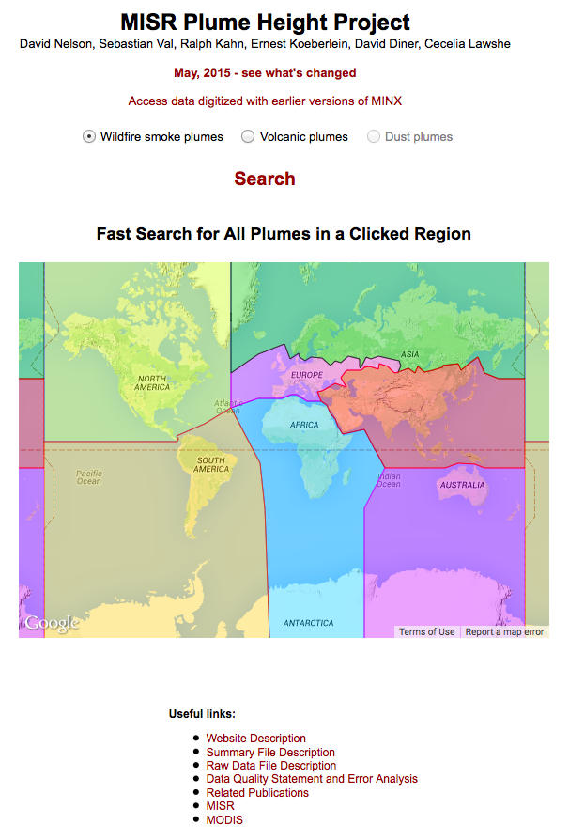
Plume Project Website - 1 http://misr.jpl.nasa.gov/getData/accessData/MisrMinxPlumes2/
The MISR Plume Height Project website was redesigned in 2015 and about 16,000 digitized plumes covering the entire world for 2008 were added.
New plumes are captured with a version of the MINX software that uses both red and blue band height retrievals, resulting in many more retrievals of higher quality over low AOD smoke and in regions of bright terrain.
Older plumes will be converted to the new format, but are still accessible from the original website:
http://misr.jpl.nasa.gov/getData/accessData/MisrMinxPlumes.
Select the type of aerosol plume you wish to retrieve from the database. Additional volcanic plumes will be added in the near term, and dust plumes will be added in the future.
David Nelson, Ralph Kahn, Sebastian Val, Ernest Koeberlein, Mike Tosca, David Diner, Cecelia Lawshe
Go to the next slide to see the result of clicking on the Search link
Click on any of the 7 geographic regions to retrieve all the plumes in the database for that region.
Refer to the documents in these links for a description of the database and how to use it.
We gratefully acknowledge support from NASA and the EPA for this work. We also acknowledge contributions by the Raytheon Company and NASA Langley Atmospheric Science Data Center.

Slide 9
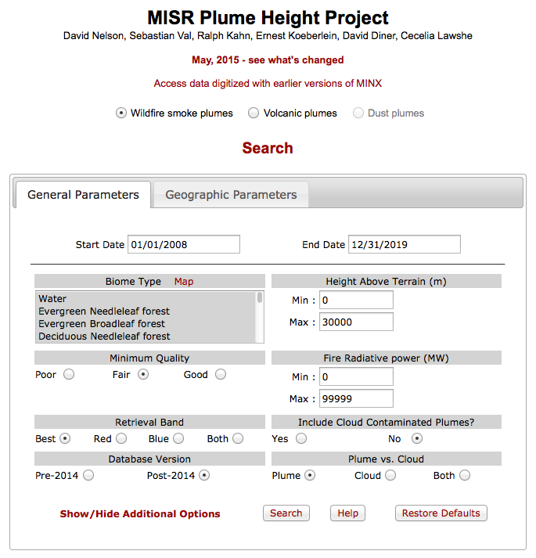
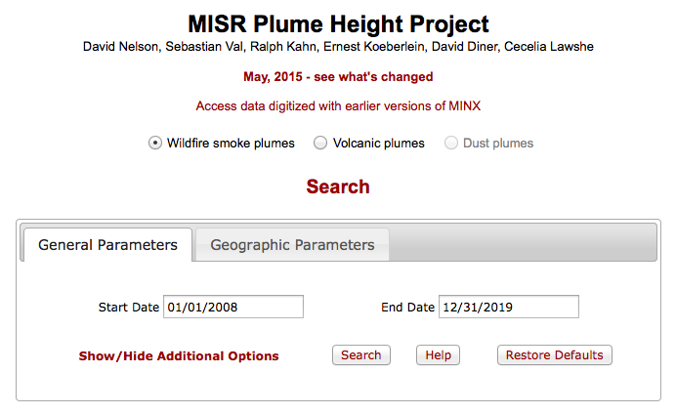
Plume Project Website - 2
Database retrievals work by searching through parameters in plume Summary files. You can download a Summary file after each successful search, and you can download some or all of the raw data files for each plume.
The plumes your search retrieves satisfy all the constraints you impose with your parameter selections.
The default values are reasonable selections. To retrieve all available plumes, you need to set “Minimum Quality” to Poor, “Include Cloud Contaminated Plumes” to Yes, “Plume vs. Cloud” to Both and “Retrieval Band” to Both.
Both red-band and blue-band retrievals are available for
each plume digitized after 2014. If you choose to retrieve
both versions, the number of results retrieved will double.
Hover over controls to see context-sensitive help messages.
David Nelson, Ralph Kahn, Sebastian Val, Ernest Koeberlein, Mike Tosca, David Diner, Cecelia Lawshe
Click on the Map link to show a global map of the MODIS IGBP biome classification for 2008.
David Nelson, Ralph Kahn, Sebastian Val, Ernest Koeberlein, Mike Tosca, David Diner, Cecelia Lawshe
If the Start and End Dates alone don’t satisfy your search requirements, click this link to see more options on the General Parameters tab.
Click Help to see a page describing each control. Click Restore Defaults to redraw the tab with all controls restored to their original values.

Slide 10
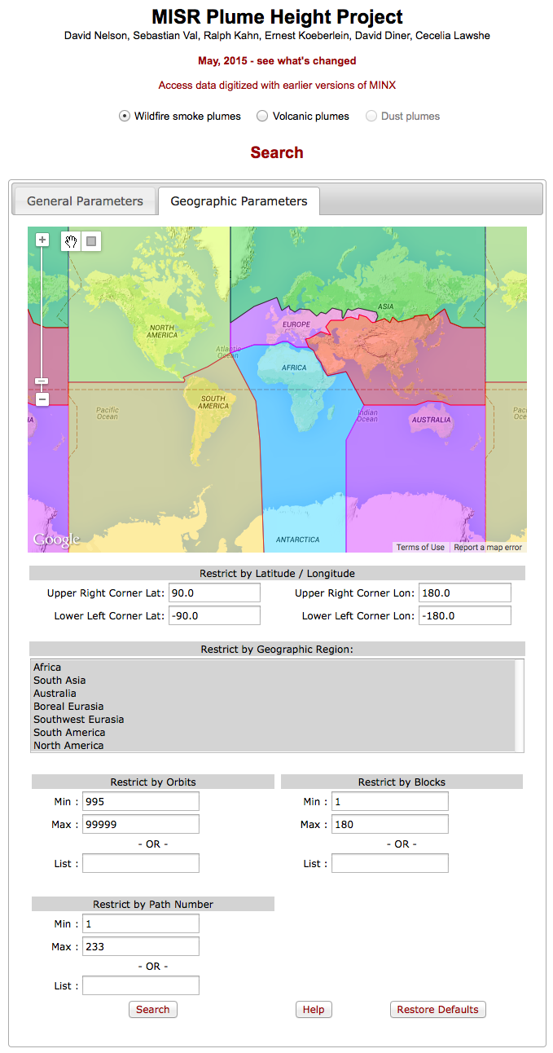
Plume Project Website - 3
David Nelson, Ralph Kahn, Sebastian Val, Ernest Koeberlein, Mike Tosca, David Diner, Cecelia Lawshe
If you clicked the Geographic Parameters tab, a Google map is presented that you can pan and zoom.
One or several of the 7 colored regions of the map can be toggled by selecting region names from the Restrict by Geographic Region list box.
The unusual geographic regions in Eurasia were chosen to closely match the boundaries between major changes in biomes.
The Restrict by Orbits controls select for temporal, not geographic criteria, because MISR orbits are numbered sequentially beginning with 995 on February 24, 2000.
The Restrict by Paths controls select for geographic criteria, because MISR paths are numbered sequentially from east to west.
The Restrict by Blocks controls select for geographic criteria, because all 180 blocks have boundaries that lie at the same latitude for every MISR path.
The plumes your search retrieves satisfy all the constraints you impose with your parameter selections in this tab as well as in the General Parameters tab.
List: boxes allow you to enter comma-separated lists of orbits, paths or blocks.
Click the Search button to begin the database search.
Next slide

Slide 11
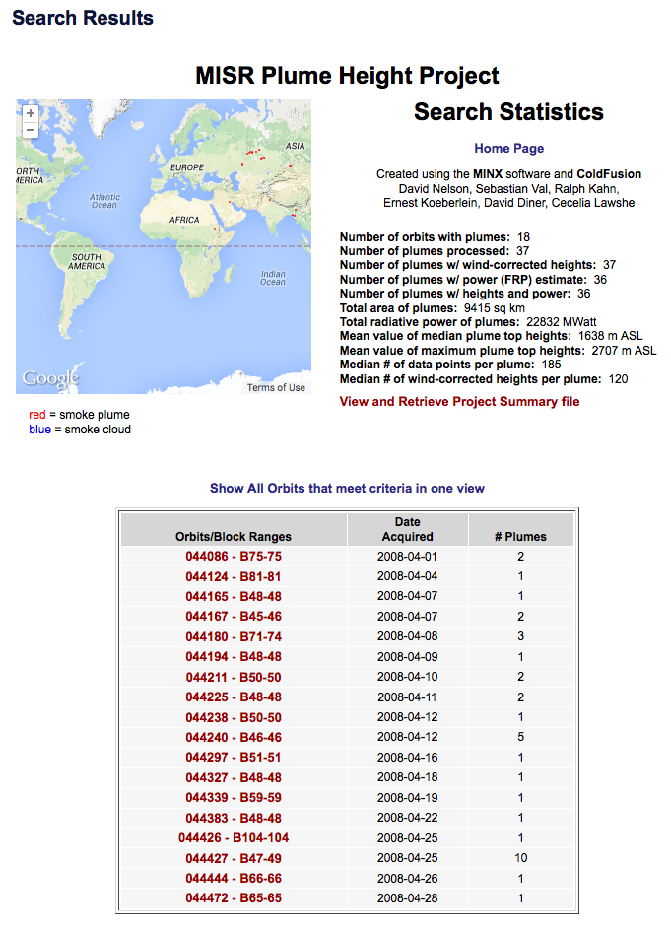
Plume Project Website - 4
The Search Results page shows a map of plume locations and a table of MISR orbits containing plumes that satisfied the search requirements.
The map can be panned and zoomed. When zoomed in, the red or blue plume or cloud symbols increase in size. Their relative sizes represent the fire radiative power that was captured with them from MODIS thermal anomaly data during digitizing.
Each entry in the Orbit/Block Ranges column of the results table is a link to another page that gives you access to plume images and raw data files for individual plumes.
David Nelson, Ralph Kahn, Sebastian Val, Ernest Koeberlein, Mike Tosca, David Diner, Cecelia Lawshe
Table showing statistics for search results
Link to view and download Summary table containing one row of 44 parameters for each plume retrieved
Link to view a list of every plume retrieved in this search
Search results table
Clicking a link in this table shows another table containing all plumes for the selected orbit (next slide)

Slide 12
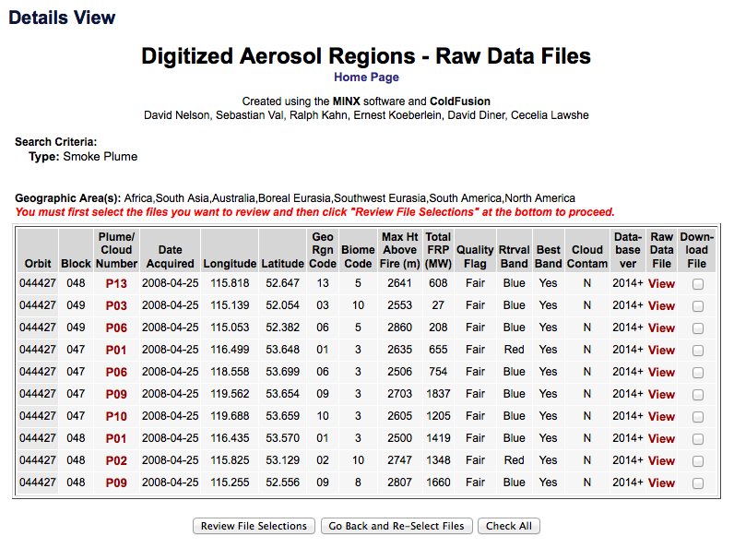
Plume Project Website - 5
The Details View page contains a table that lists some of the attributes for each plume retrieved in the search belonging to the selected orbit(s). Additional attributes are available in the Summary table.
You can toggle the sort order for any attribute whose column title is a colored link.
After you select plumes to download, click the Review File Selections button at the bottom to confirm your selections and to order the data by entering the email address where you want your selections sent.
After placing your order, you’ll receive an email with a cURL file and instructions for downloading your data. You need the “curl” app to do this – it’s standard with Macs – PC users can download a free copy.
Click on a View link to see a text file containing the raw (text) data file for the plume
Click on a column header to sort the plume records by that attribute
David Nelson, Ralph Kahn, Sebastian Val, Ernest Koeberlein, Mike Tosca, David Diner, Cecelia Lawshe
Check all the Download File checkboxes for the plumes whose raw data files you want to download, or click the Check All button at the bottom to select all raw data files
Click on a Plume/Cloud Number link to see a group of images of the plume and the height/wind retrieval results (next slides)

Slide 13
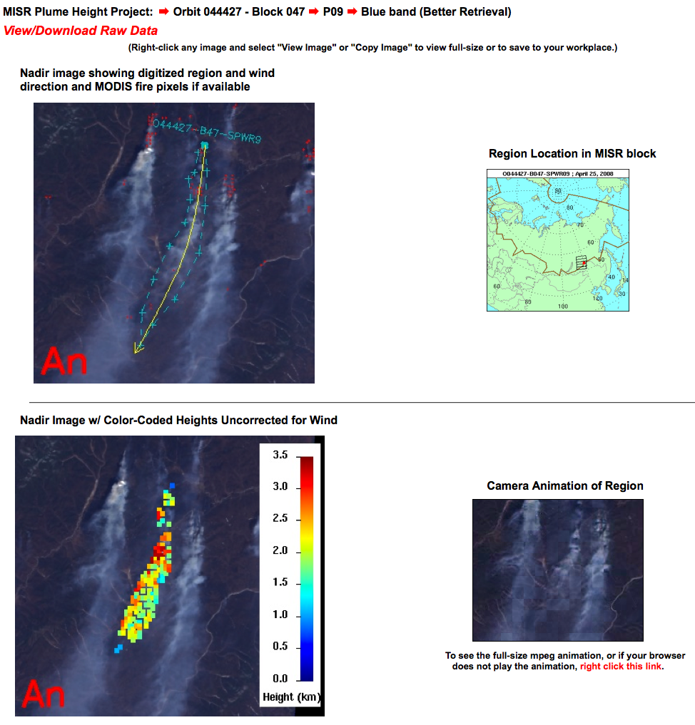
Plume Project Website - 6
These are the first four images shown for every plume:
This line identifies the current plume, including the MISR band with which it was retrieved, and states whether it is the Better or the Poorer of the red-band or blue-band retrievals, as judged by a MISR staff member
The View/Download Raw Data link is another way to access the raw data (text) file
Location map shows where this plume and nearby MISR blocks are found
Two static images of the An cameras view of this scene are displayed: one showing the digitized polygon, direction line and plume name/plume origin, and the other showing successful retrievals of wind-corrected heights, color-coded and with a scale bar
The animation window plays a 9-frame video, 1 image per MISR camera, that is best viewed by opening the animation in another window, then grabbing the handle and dragging it back-and-forth

Slide 14
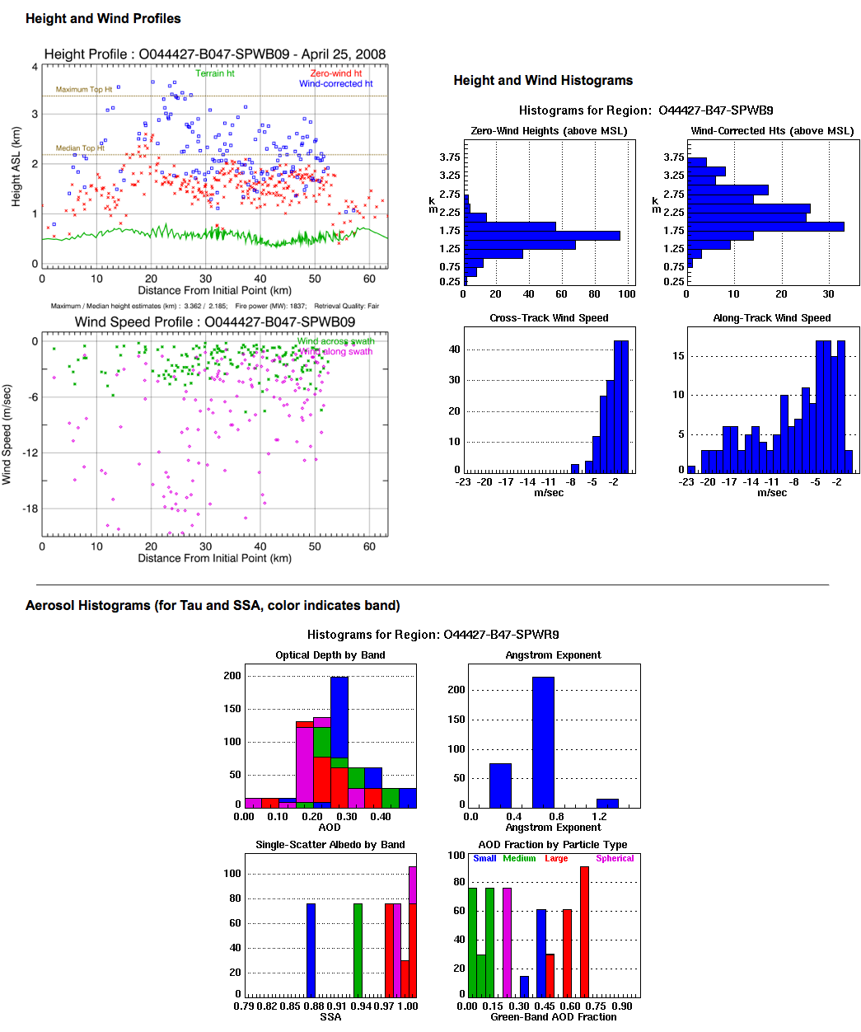
Plume Project Website - 7
These are the remaining three images shown for every plume:
Four histograms summarize the zero-wind and wind-corrected heights and the across-swath and along-swath wind speeds retrieved for this plume – they correspond to the four parameters plotted in the profile plots to their left
The height and wind profiles display terrain heights and retrieval results projected onto a line of section that runs from the first point digitized (the origin) to the point farthest from the origin
Aerosol histograms summarize MISR standard product aerosol retrievals near the digitized plume (aerosol optical depth, angstrom exponent, single-scatter albedo and fraction of AOD attributable to small, medium and large particles) – their native resolution is 17.6 km

Slide 15
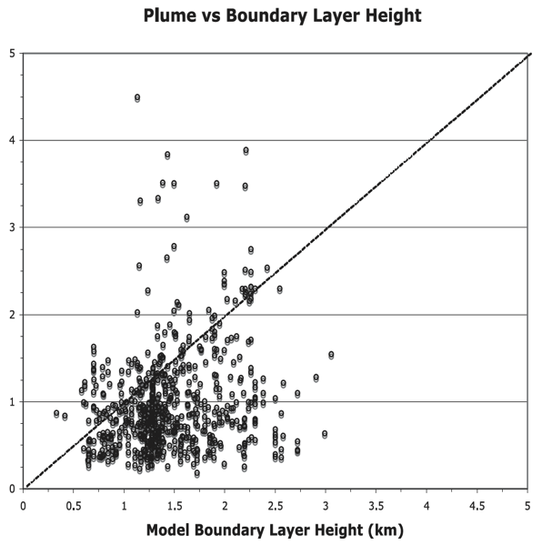
Alaska-Yukon Fire Plume Statistics, Summer 2004
MINX found that at least 10% of wildfire smoke plumes reached the free troposphere. CALIOP concluded this was very rare
CALIOP’s swath width is ~ 4000 times narrower than MISR’s suggesting that poor horizontal sampling is responsible
0.5 km above boundary layer
Boundary layer heights computed using GEOS-4
MISR Plume Height (km)
First science results from Plume Website data
R. Kahn, Y. Chen, D. Nelson et al., GRL 2008

Slide 16
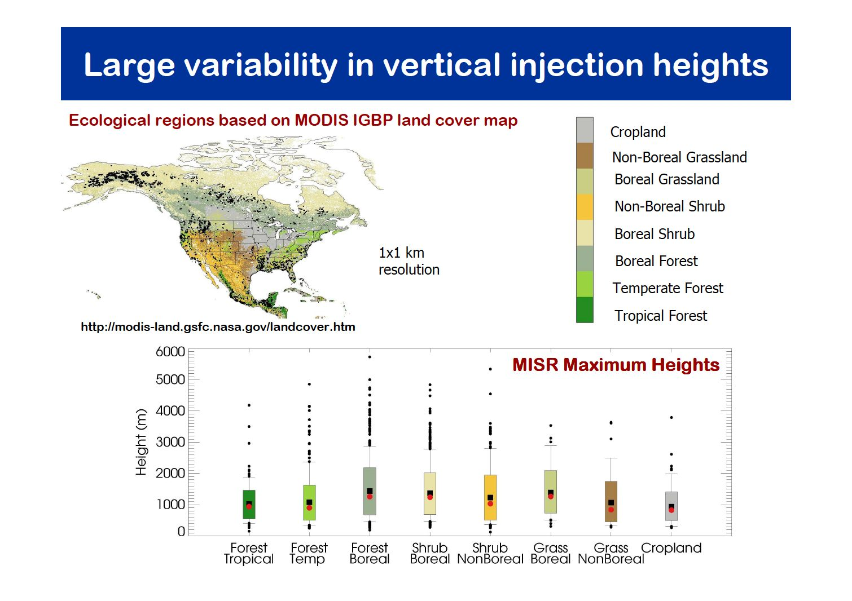
Val Martin et al., Atm. Chem. Phys. 10, 1491-1510, 2010
16

Slide 17
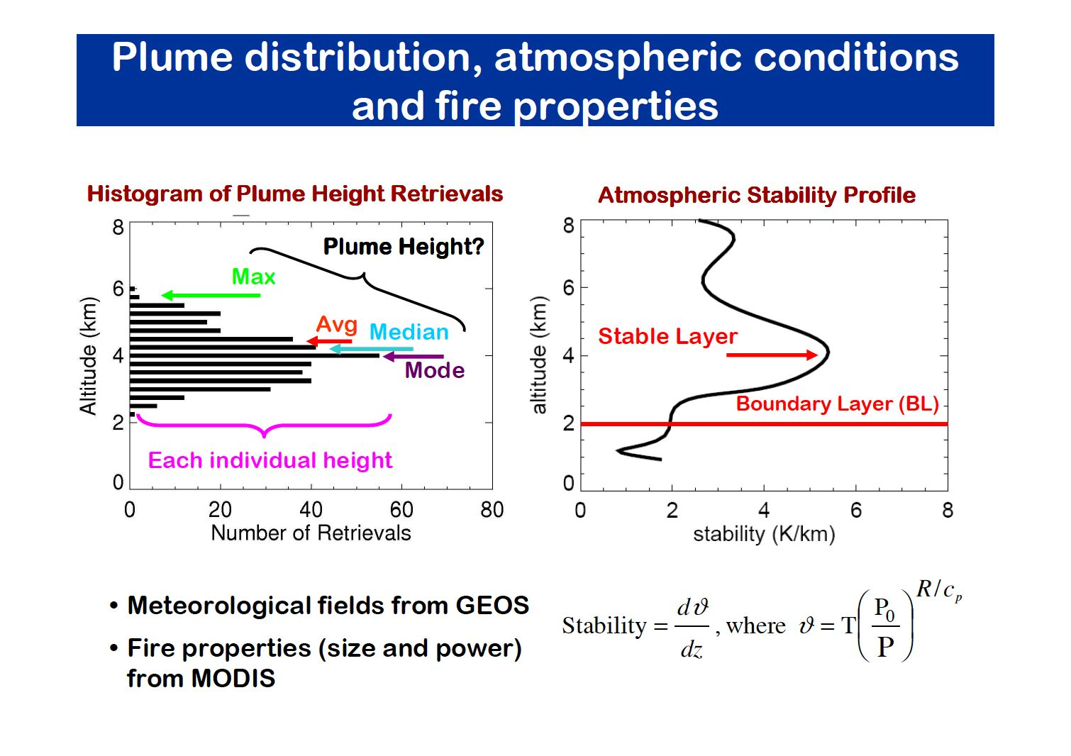
Wildfire Smoke Plume Database
Val Martin, et al., ACP 2010
Courtesy of Maria Val Martin

Slide 18
Contents
Scientific motivation for MINX
MISR Plume Project website
Animations and interpretations with MINX
Smoke plume over Alaska
Dust in Taklamakan Basin
Volcanic ash over Chile
Snow storm in Antarctica

Slide 19
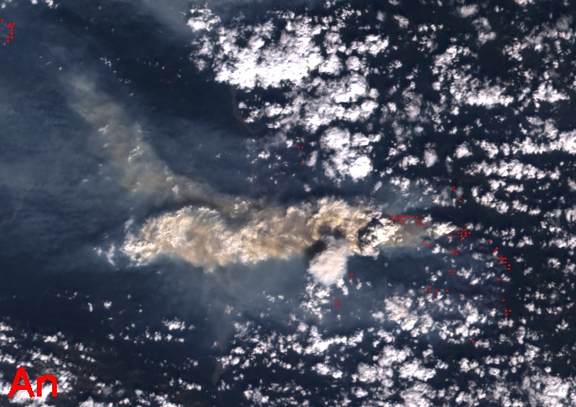
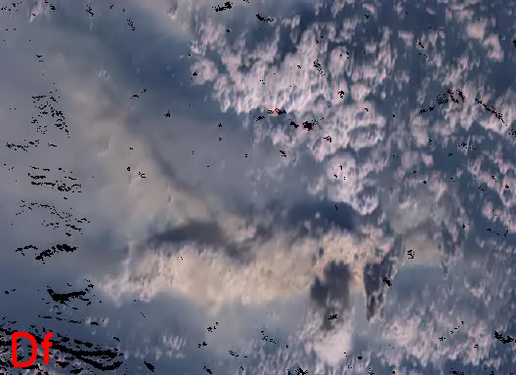
Smoke Plumes - Alaska, USA Orbit 24152, July 2, 2004
9-camera animation
100 km
An (nadir) image
Hover over window then click arrow to start movie

Slide 20
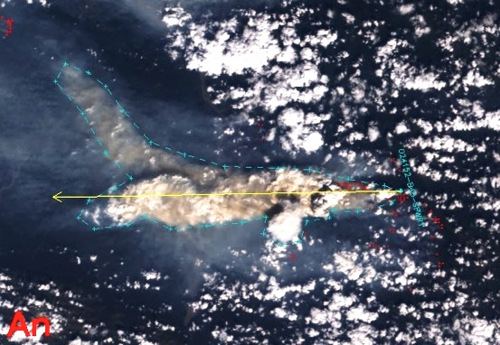
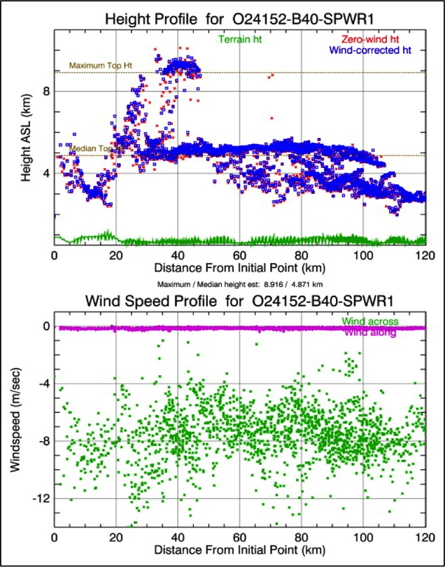
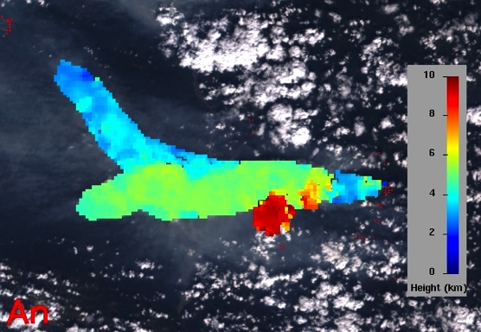
Alaska Fire, July 2, 2004 (5054 MW)
Lower plume
Pyrocumulus clouds
Upper plume
Plume origin
Upper plume
Lower plume
Pyrocumulus clouds

Slide 21
Contents
Scientific motivation for MINX
MISR Plume Project website
Animations and interpretations with MINX
Smoke plume over Alaska
Dust in Taklamakan Basin
Volcanic ash over Chile
Snow storm in Antarctica

Slide 22
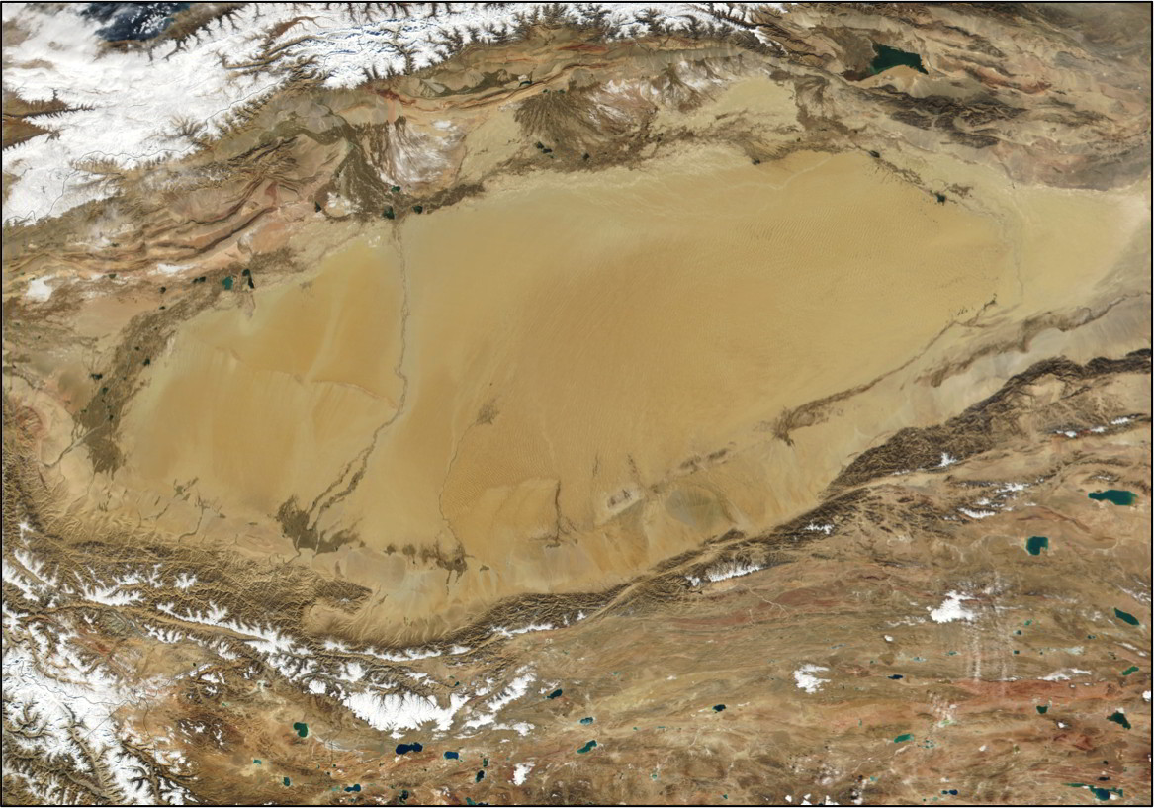
Dust Plumes - Taklamakan Desert in Tarim Basin
North of Tibetan Plateau (MODIS Image)
Area of MINX animation
1300 km

Slide 23
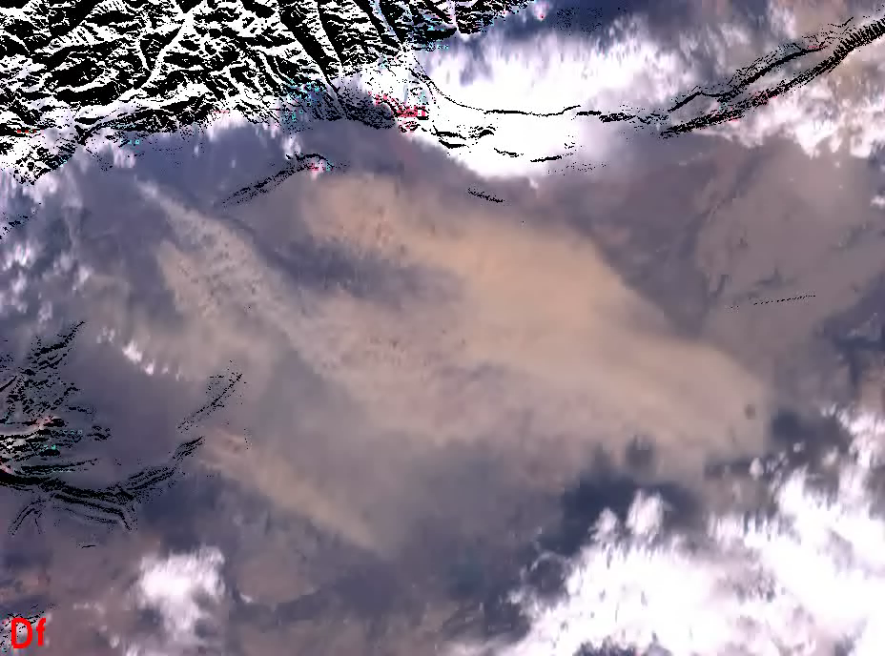
Taklamakan Dust – Orbit 17575 – April 8, 2003
Hover over window then click arrow to start movie

Slide 24
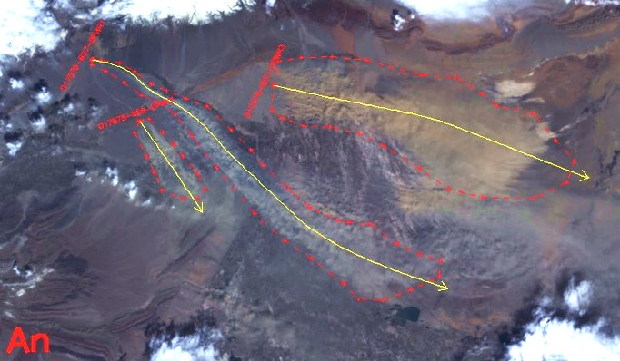
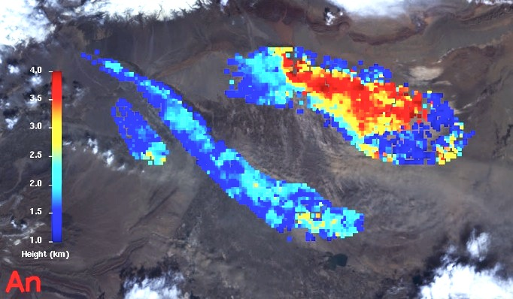
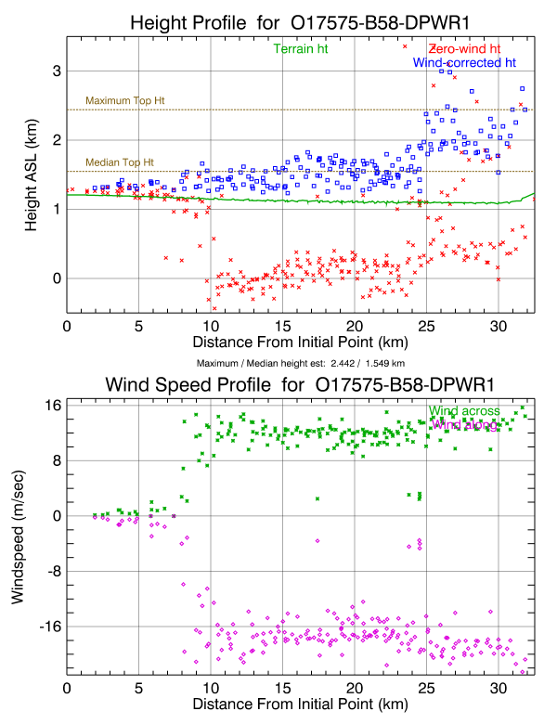
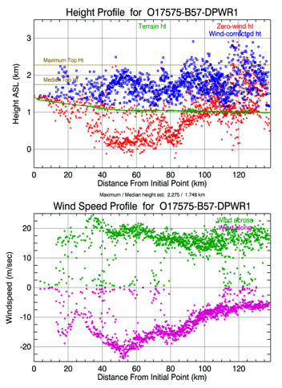
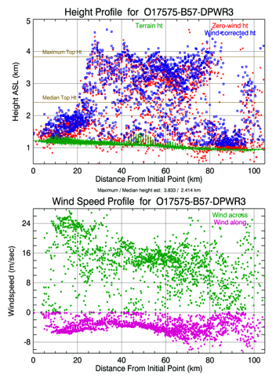
Taklamakan Dust – Orbit 17575 – April 8, 2003
3
1
2
1
2
3
Several dust sources are narrow and linear - probably dry stream beds
Wind speed increases abruptly on plume 1
Dust rises about 3 km on plume 3
22 m/sec
28 m/sec

Slide 25
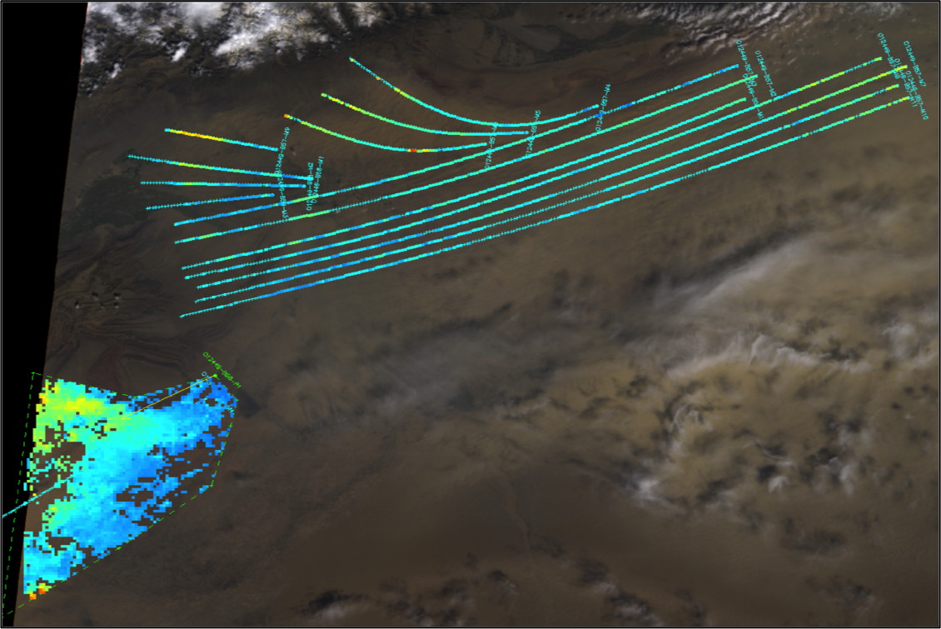
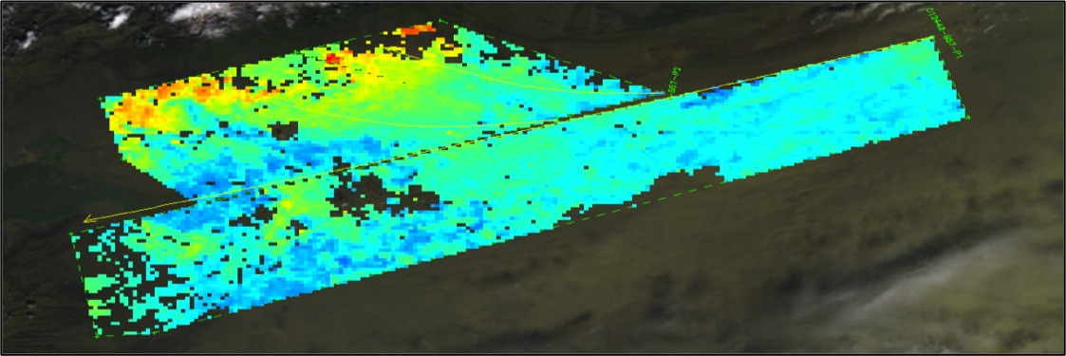
Taklamakan Desert
Digitizing Alternatives – Lines or Polygons
Courtesy of Michael Goetz, Olga Kalashnikova and Mike Garay, JPL, 2011

Slide 26
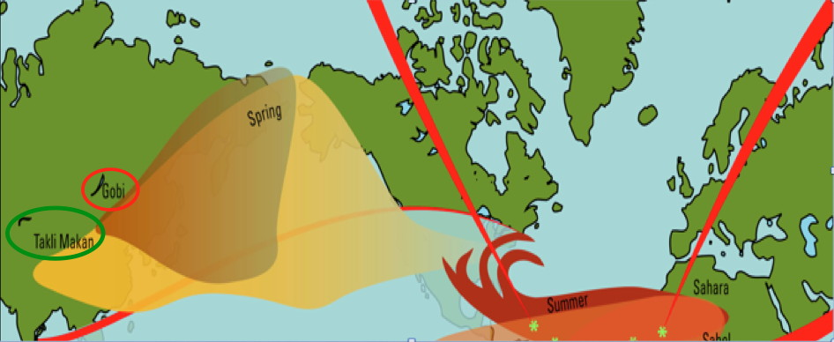
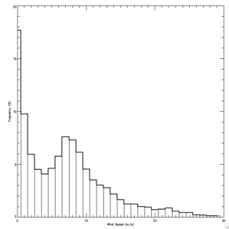
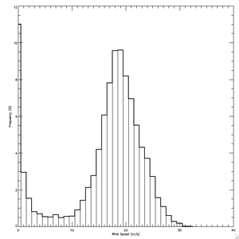
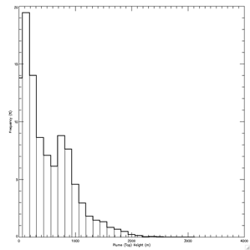
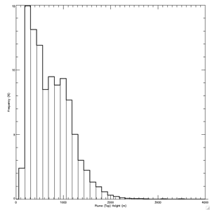
Taklamakan vs Gobi Dust Plume Heights and Wind Speeds
Taklamakan
Wind speed
Gobi
Wind speed
Taklamakan
Plume height
above terrain
Gobi
Plume height
above terrain
Gobi
Wind speed
8 m/sec
800 m
19 m/sec
900 m
Courtesy of Michael Goetz, Olga Kalashnikova and Mike Garay, JPL, 2011

Slide 27
Contents
Scientific motivation for MINX
MISR Plume Project website
Animations and interpretations with MINX
Smoke plume over Alaska
Dust in Taklamakan Basin
Volcanic ash over Chile
Snow storm in Antarctica

Slide 28
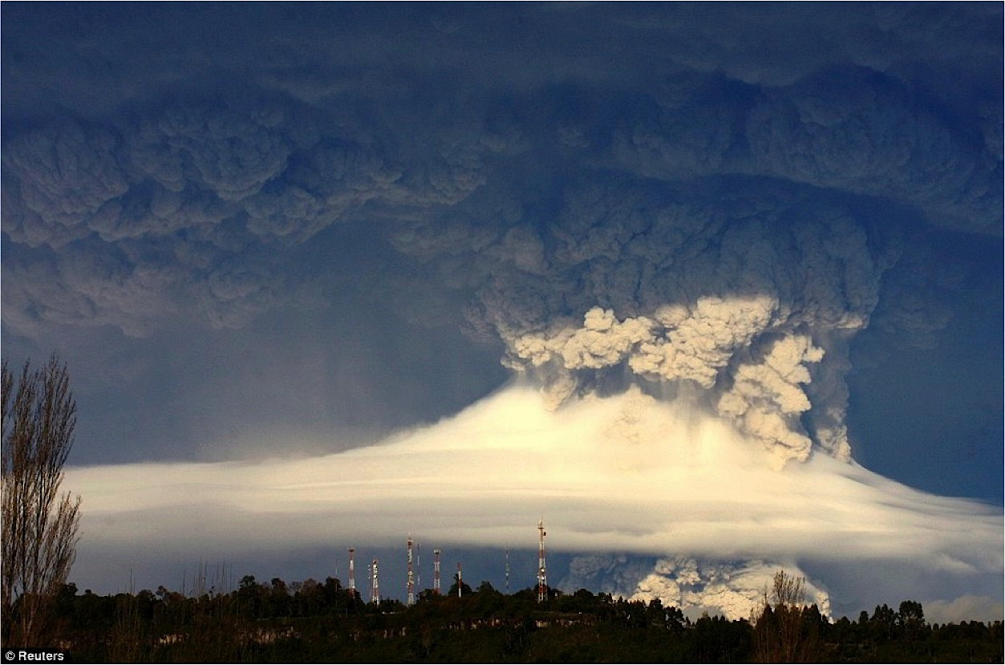
Volcanic Plumes - Puyehue-Cordon, Chile - June, 2011

Slide 29
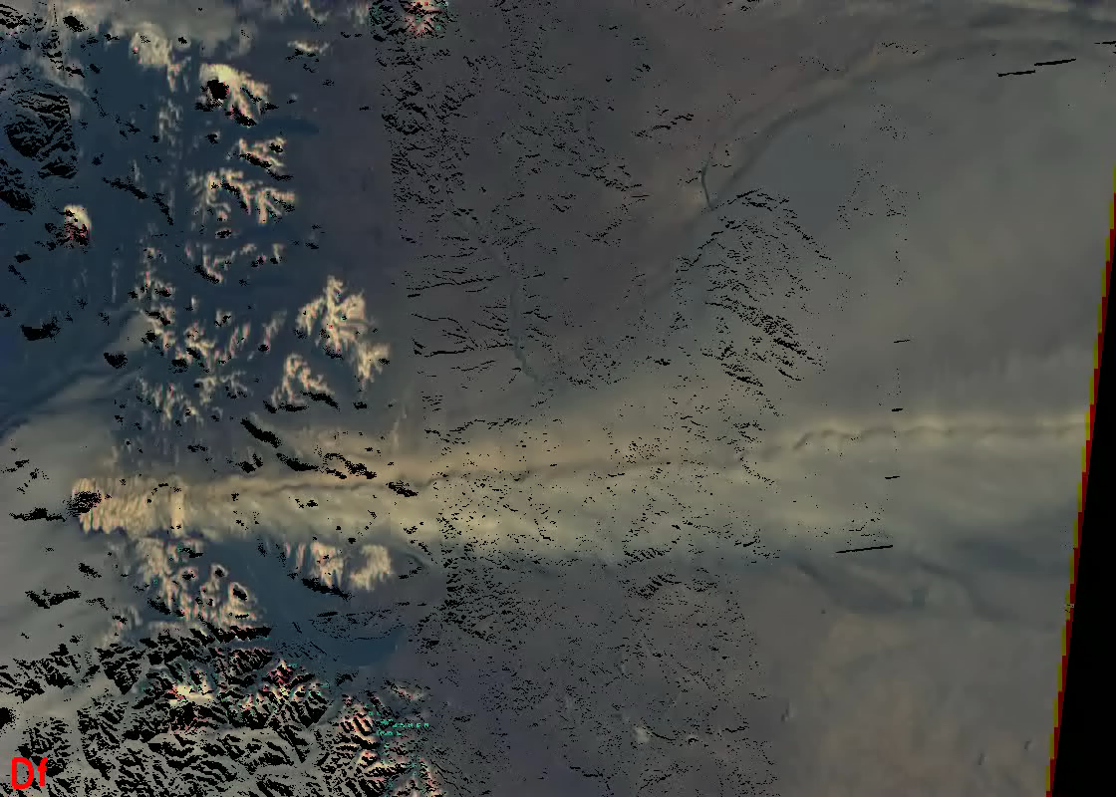
Puyehue-Cordon Eruption - Animation
Hover over window then click arrow to start movie

Slide 30
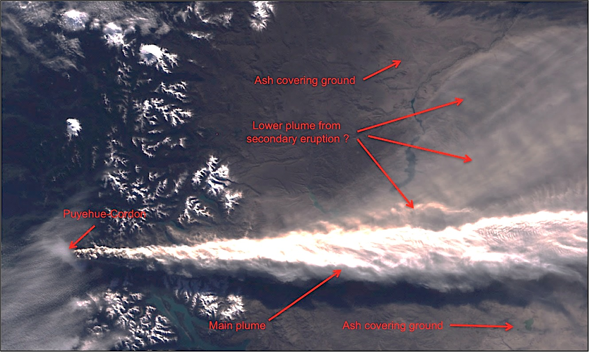
Puyehue-Cordon Eruption Orbit 61064 - June 11, 2011
275 km

Slide 31
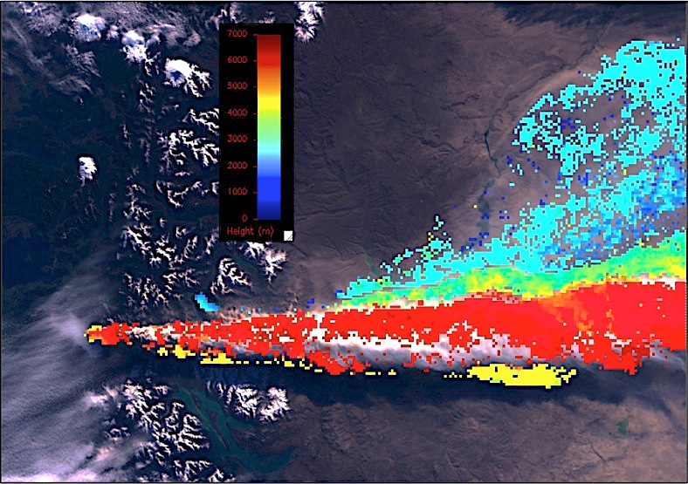
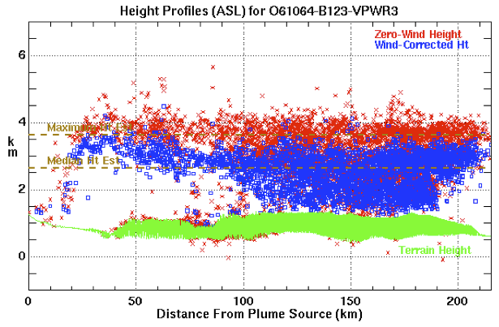
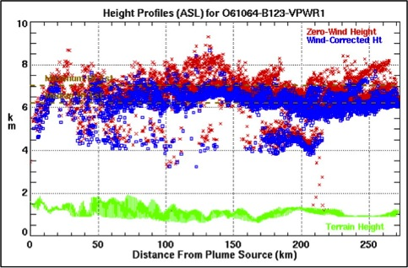
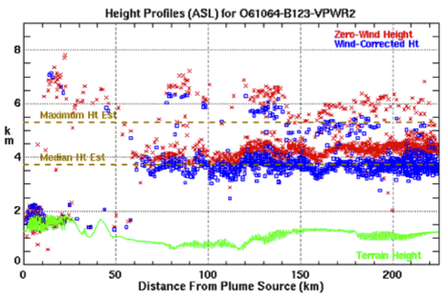
Puyehue-Cordon – Height Retrievals

Slide 32
Contents
Scientific motivation for MINX
MISR Plume Project website
Animations and interpretations with MINX
Smoke plume over Alaska
Dust in Taklamakan Basin
Volcanic ash over Chile
Snow storm in Antarctica

Slide 33
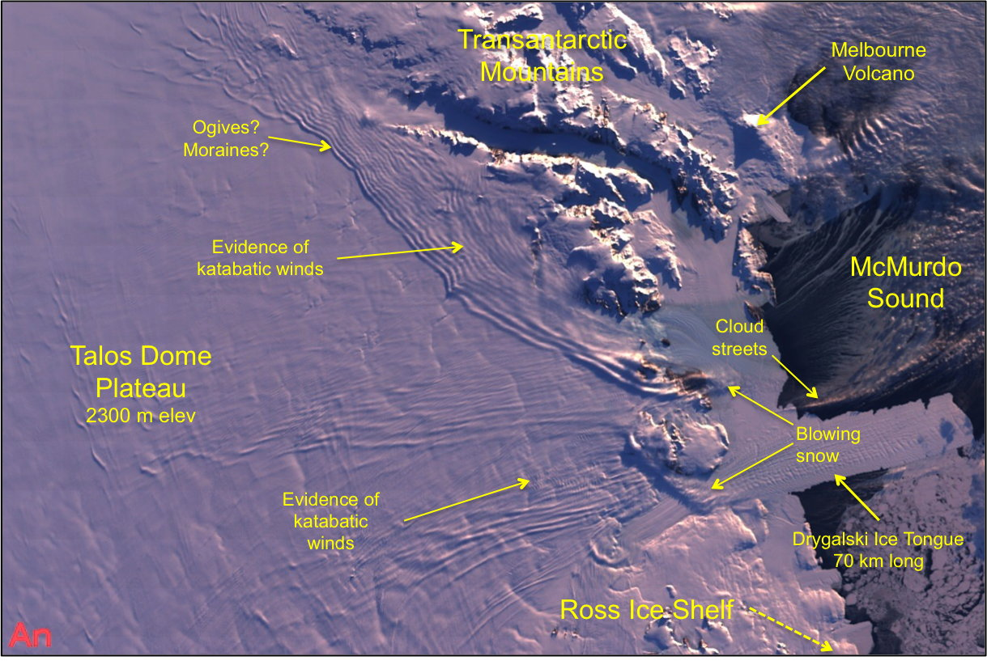
Snow Plumes - Antarctic Blizzard Orbit 38671 - March, 2007
340 km

Slide 34
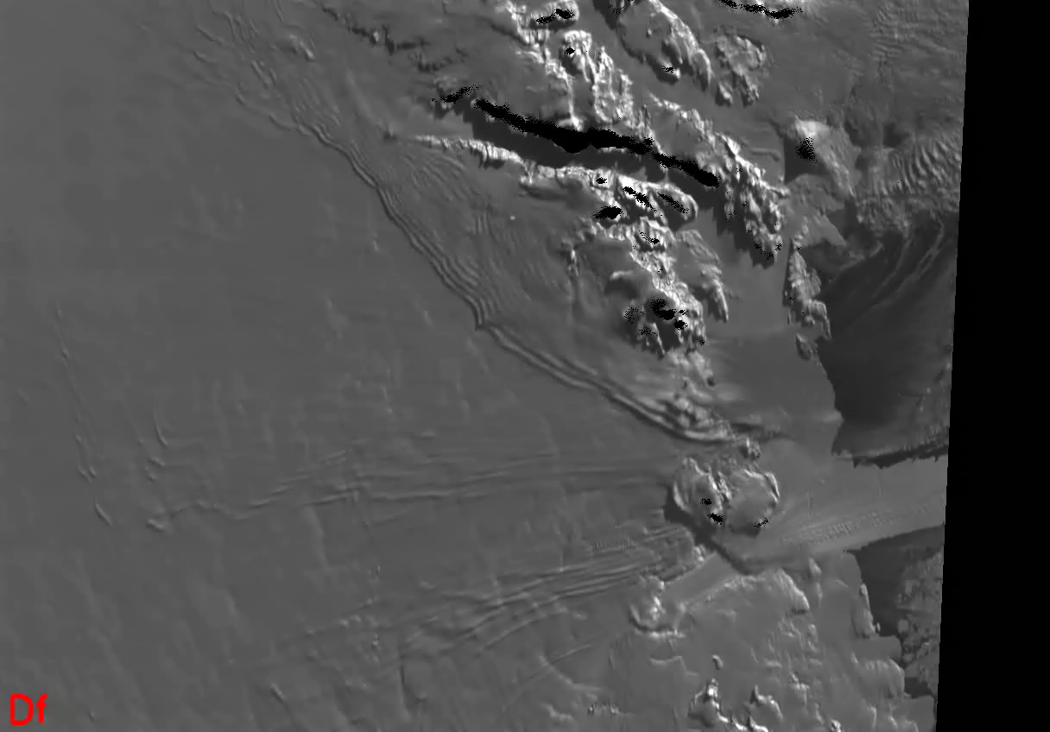
Antarctic Blizzard – Red-band Animation
Hover over window then click arrow to start movie

Slide 35
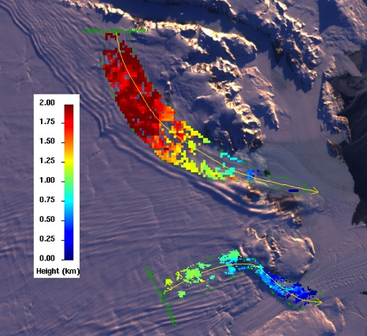
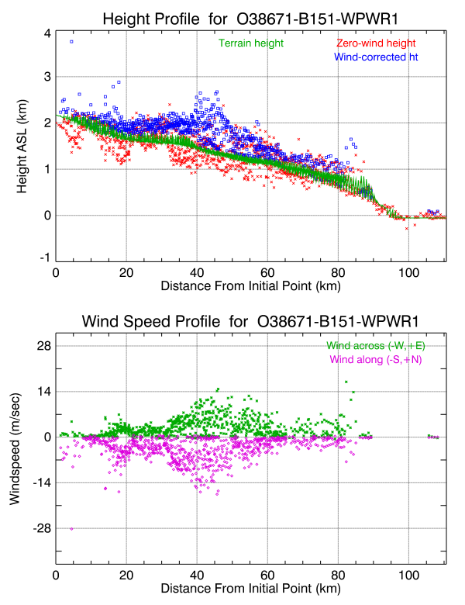
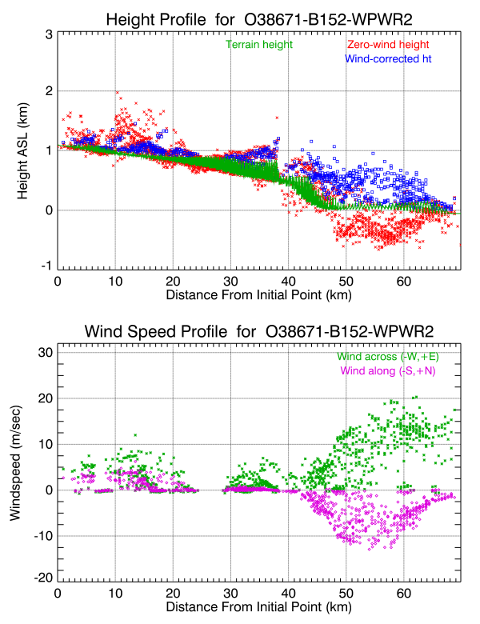
Antarctic Blowing Snow - Height/Wind Retrievals
Snow drops 2 km, and is confined to glacial ridges
Snow drops 1 km, is diverted by mountain, and becomes airborne over David Glacier
When snow remains near the surface, wind speeds are low due to transport by saltation (< 8 m/sec ~= 30 km/hr)
When snow is airborne, wind speeds are higher (~ 22 m/sec ~= 80 km/hr)

Slide 36
References
Kahn et al., (2008). “Wildfire smoke injection heights: Two perspectives from space”, Geophys. Res. Lett., 35, L04809, doi: 10.1029/2007GL032165.
Kahn, R.A., and J.A. Limbacher, 2012. Eyjafjalljökull Volcano Plume Particle-Type Characterization from Space-Based Multi-angle Imaging. Atmosph. Chem. Phys. 12, 9459–9477, doi:10.5194/acp-12-9459-2012.
Mims, S.R., R.A. Kahn, C.M. Moroney, B.J. Gaitley, D.L. Nelson, and M.J. Garay, 2009. MISR Stereo-heights of grassland fire smoke plumes in Australia. IEEE Trans. Geosci. Remt. Sens. 48, 25-35.
Nelson, D.L., M.J. Garay, R.A. Kahn, and B.A. Dunst, 2013. Stereoscopic Height and Wind Retrievals for Aerosol Plumes with the MISR INteractive eXplorer (MINX). Remt. Sensing 5, 4593-4628; doi:10.3390/rs5094593.
MISR Plume Height Project websites (the older website will be retired after data have been converted to the newer website’s format) -
older data: http://www-misr.jpl.nasa.gov/getData/accessData/MisrMinxPlumes/
newer data: http://www-misr.jpl.nasa.gov/getData/accessData/MisrMinxPlumes2/
Scollo, S. R.A. Kahn, D.L. Nelson, M. Coltelli, D.J. Diner, M.J. Garay, and V.J. Realmuto, 2012. MISR observations of Etna volcanic plumes. J. Geophys. Res. 117, D06210, doi:10.1029/2011JD016625.
Val Martin, M., R.A. Kahn, J.A. Logan, R. Paugam, M. Wooster, and C. Ichoku, 2012. Space-based observations constraints for 1-D plume-rise models. J. Geophys. Res. 117, D22204, doi:10.1029/2012JD018370.
Val Martin, M., J.A. Logan, R.A. Kahn, F-Y. Leung, D. Nelson, and D. Diner, 2010. Fire smoke injection heights over North America constrained from the Terra Multi-angle Imaging SpectroRadiometer. Atm. Chem. Phys. 10, 1491-1510.
Val Martin, M., et al, 2009. “Vertical Transport of Wildfire Smoke over North America: Merging Satellite Observations and Models”, presentation to European Geosciences Union.

